Slide 1
Significance test in correlation
Yue Zhao
03/28/2016
Statistics notes

Slide 2
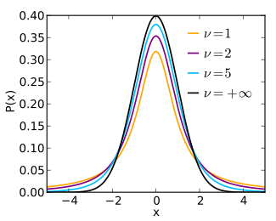
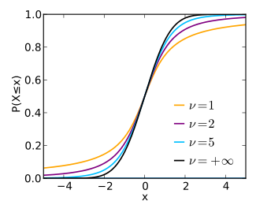
Known: x and y are two vectors of size n, mean and sd
Goal: Test the correlation between x and y
Pearson Correlation Coefficient: determine the strength of the correlation
r = cov(x, y) / sd(x) * sd(y)
p value: determine the significance of the correlation
H₀ (The null hypothesis): r = 0, implying that the two variables are uncorrelated
Dof (degree of freedom) = n - 2
t = r * sqrt((n – 2) / (1 – r^2))
p = 2 * pt(-abs(t), Dof)
pt is the cumulative distribution function of t
Student’s t distribution
Probability density function
Cumulative distribution function
Notes inspired by Dmitriy: the prerequisite is to assume x and y are normally distributed. Give n, x is one sample of X, y is one sample of Y, for each (x, y), there is a r and t. If sample infinite times, there is a distribution of r and t. t reflects the probability to get the corresponding t. If X and Y are not correlated, infinite times should give rise to the t distribution. If X and Y are correlated, it give rise to a crowd of t far from 0.

Slide 3


Student’s t distribution
v is the number of degrees of freedom and gamma is the gamma function.
When v goes to infinity, t distribution is close to the normal distribution (the black curve in PDF)
Probability density function
Cumulative distribution function
Notes inspired by Dmitriy: Because given the number of degrees of freedom, the t distribution is universe, the prerequisite is X and Y are normally distributed.

Slide 4
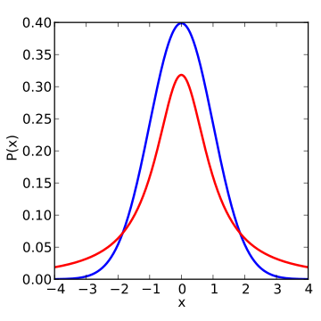
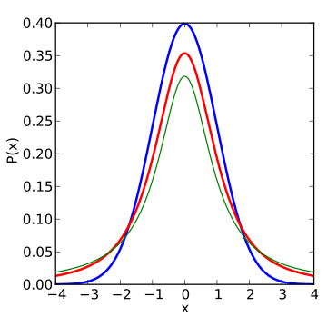
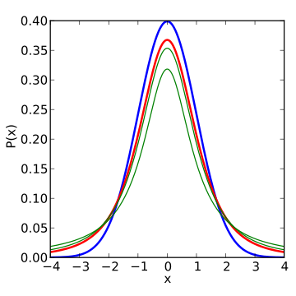
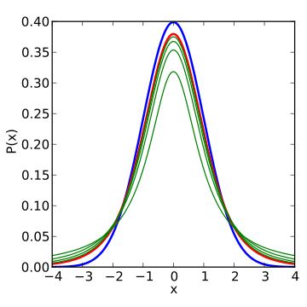
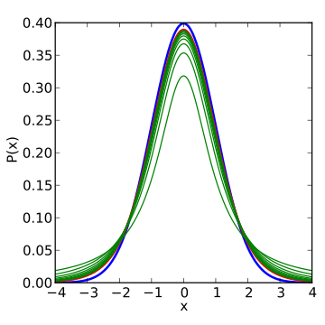

Density of the t-distribution (red) for 1, 2, 3, 5, 10, and 30 degrees of freedom compared to the standard normal distribution (blue). Previous plots shown in green

Slide 5
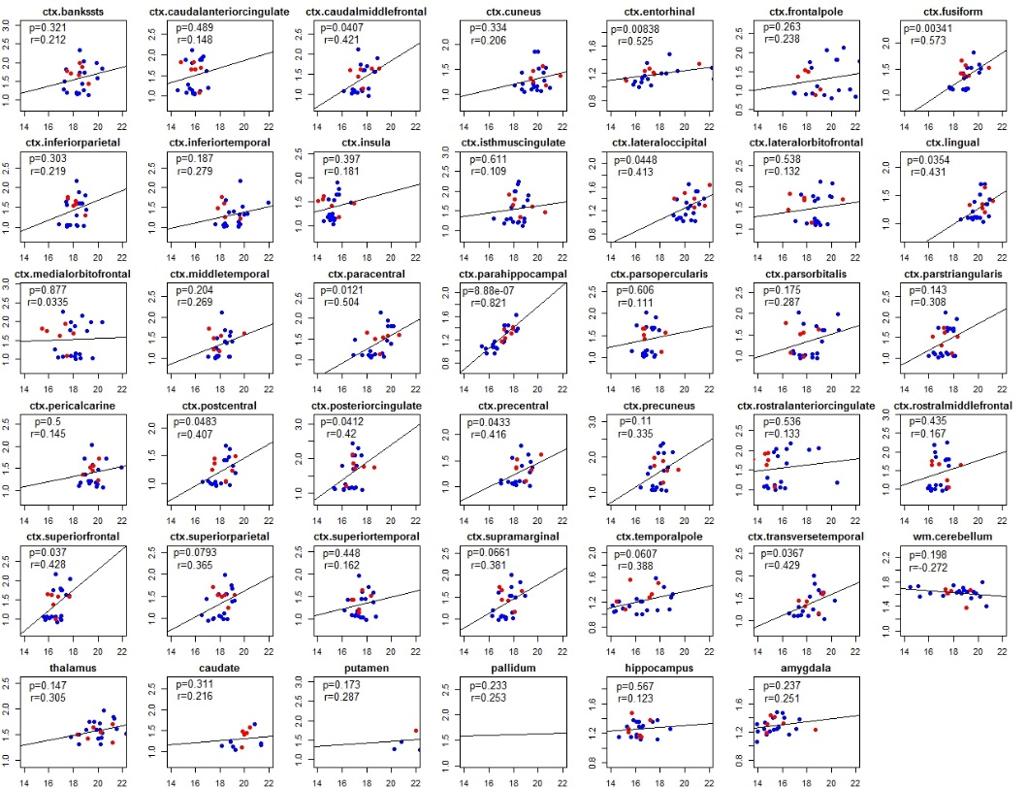
Example: Test the correlations of regional R2* and SUVR across 24 subjects
Data:
41 FreeSurfer regions (34 cortical regions + 7 subcortical regions, including wm.cerebellum, thalamus, caudate, pallidum, putamen, hippocampus, amygdala, excluding ctx.cerebellum because it is the reference region for SUVR and SUVR is all 1
24 sujects (24 observations)
Procedure:
For each region, calculate r and p for the correlation between R2* and SUVR through 24 subjects (Fig. 1)
r = cov(R2*[, i], SUVR[, i])
p = cov.test(R2*[, i], SUVR[, i])
plot(r, p)
Result (Fig. 2)
p
r
Fig. 1 R2* (x) vs. SUVR (y)

Slide 6
Simple Student’s t-test Significance test in group difference
Yue Zhao
03/28/2016
Statistics notes

Slide 7
Known: x and y are two vectors of size n, mean(x), mean(y), sd(x), sd(y)
Goal: Test the significance of the difference of the mean of x and y
Determine if sd(x) == sd(y),
Calculate standard error (se) and degrees of freedom (Dof) using different ways
H₀ (The null hypothesis): r = 0, implying that the two mean are not different
t = mean(x) – mean(y) / se
p = 2 * pt(-abs(t), Dof)
pt is the cumulative distribution function of t
Note: compare p value for the correlation and t test
The t is determined in different ways
but use the same t distribution
R code
t_test <- function(m1, m2, s1, s2, n1, n2, m0=0, equal.variance=FALSE) {
#m1, m2: the sample means
#s1, s2: the sample standard deviations
#n1, n2: the sample sizes
#m0: the null value for the difference in means to be tested for. Default is 0
#equal.variance: whether or not to assume equal variance. Default is FALSE.
if (equal.variance) {
se <- sqrt((1/n1 + 1/n2) * ((n1-1)*s1^2 + (n2-1)*s2^2) / (n1+n2-2))
df <- n1 + n2 -2
} else {
se <- sqrt(s1^2/n1 + s2^2/n2)
df <- (s1^2/n1 + s2^2/n2)^2 / ((s1^2/n1)^2/(n1-1) + (s2^2/n2)^2/(n2-1))
}
t <- (m1 - m2 - m0) / se
result <- c(t, 2*pt(-abs(t), df))
names(result) <- c('t', 'p-value')
return(result)
}

Slide 8
Linear Regression
Model Regression 1
Assumptions:
The independent variable X is measured without error;
For any given value Xi of X, Y s are independently and normally distributed.
Y(i, j) = a + bX(i) + e(i, j) e(i, j) are assumed to be normally distributed error terms with a mean of zero;
Figure 14.4 on P456, Biometry
With intercept
y and x are vectors
yfit = a + bx fitted by OLS method
b = cov(x, y) / var(x) = sum((x – mean(x))*(y – mean(y)) / sum((x – mean(x)) ^ 2)
a = mean(y) – b*mean(x)
yfit = a + bx will go through the point(mean(x), mean(y))
Significance test: y – mean(y): total variation
y – yfit: unexplained variation
yfit – mean(y): explained variation
y – mean(y) = (y – yfit) + (yfit – mean(y))
In the case of OLS, if sum the square(y – mean(y)), the cross-product term is equal to zero.
So, sum((y – mean(y)) ^ 2) = sum((y – yfit) ^ 2) + sum((yfit – mean(y)))
sum of squares total (SST) sum of squares due to error(SSE) sum of squares due to regression (SSR)
R2 = 1 – SSE / SST = SSR/SST

Slide 9
With intercept
Without intercept
In the case of ordinary least square with intercept, the cross product is zero
In the case of ordinary least square with intercept, the cross product is non zero

Slide 10
R code
#standard error of linear regression coefficient
x = SUVR_data_norm$ctx.parahippocampal
y = SUVR_data_norm$ctx.superiorparietal
#lm(y ~ x - 1) -> k = 1.1696 se = 0.1238
n = 24
k = 1.46670
yfit_0 = k * x
e0 = sum((y - yfit_0) * (y - yfit_0))
x0 = sum((x - 0) * (x - 0))
se_fit_0 = sqrt(e0 / (x0 * (n - 1)))
a <- 1.461620
b <- 0.001865
yfit <- a*x + b
e1 <- sum((y - yfit) * (y - yfit))
x2 = sum((x - mean(x)) * (x - mean(x)))
se_fit <- sqrt(e1 / (x2 * (n - 2)))

Slide 11
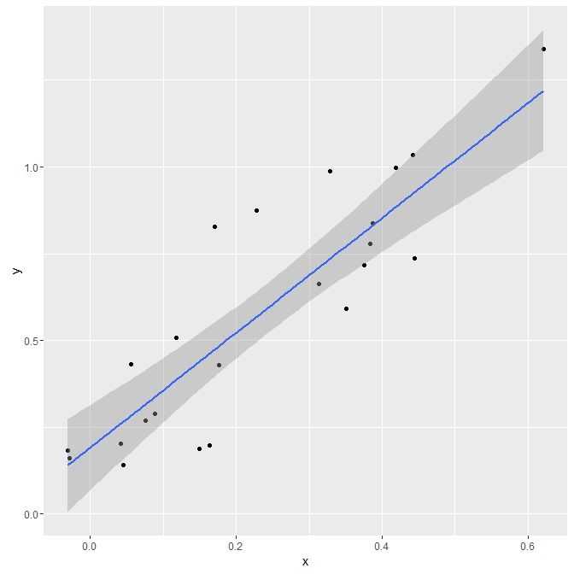
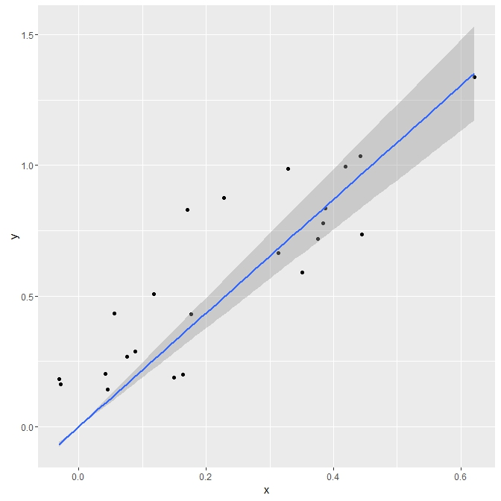
With intercept
Call: lm(formula = y ~ x)
Residuals: Min 1Q Median 3Q Max
-0.26384 -0.10206 -0.04672 0.11409 0.35548
Coefficients: Estimate Std.Error t value Pr(>|t|)
(Intercept) 0.19137 0.05919 3.233 0.00382 **
x 1.65346 0.19927 8.297 3.2e-08 ***
---
Signif. codes: 0 ‘***’ 0.001 ‘**’ 0.01 ‘*’ 0.05 ‘.’ 0.1 ‘ ’ 1
Residual standard error: 0.1706 on 22 degrees of freedom
Multiple R-squared: 0.7578, Adjusted R-squared: 0.7468
F-statistic: 68.85 on 1 and 22 DF, p-value: 3.203e-08
Without intercept
Call: lm(formula = y ~ 0 + x)
Residuals: Min 1Q Median 3Q Max
-0.22967 -0.06648 0.05945 0.23039 0.45808
Coefficients: Estimate Std. Error t value Pr(>|t|)
x 2.1744 0.1393 15.61 9.9e-14 ***
---
Signif. codes: 0 ‘***’ 0.001 ‘**’ 0.01 ‘*’ 0.05 ‘.’ 0.1 ‘ ’ 1
Residual standard error: 0.2027 on 23 degrees of freedom
Multiple R-squared: 0.9137, Adjusted R-squared: 0.91
F-statistic: 243.7 on 1 and 23 DF, p-value: 9.899e-14

Slide 12
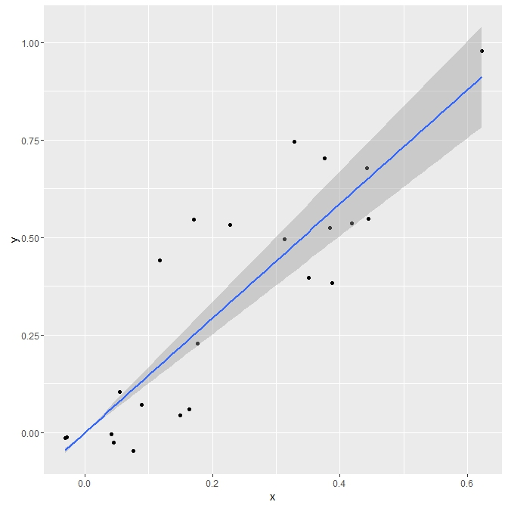
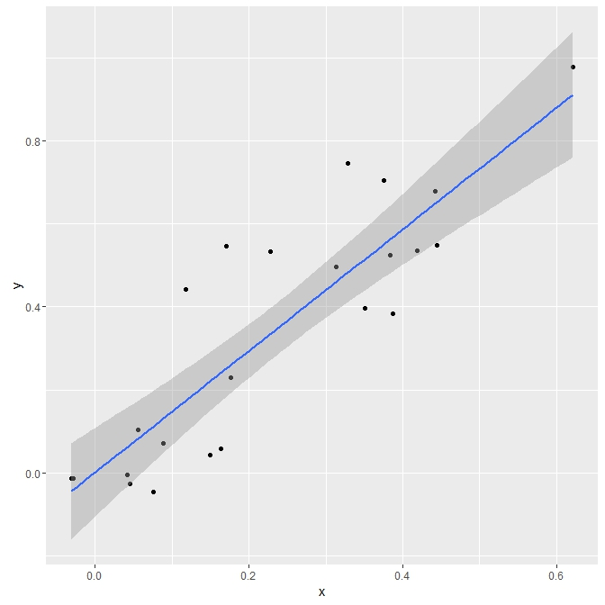
With intercept
Call: lm(formula = y ~ x)
Residuals: Min 1Q Median 3Q Max
-0.18459 -0.10272 -0.03413 0.04355 0.29547
Coefficients: Estimate Std. Error t value Pr(>|t|)
(Intercept) 0.001865 0.051519 0.036 0.971
x 1.461620 0.173453 8.427 2.47e-08 ***
---
Signif. codes: 0 ‘***’ 0.001 ‘**’ 0.01 ‘*’ 0.05 ‘.’ 0.1 ‘ ’ 1
Residual standard error: 0.1485 on 22 degrees of freedom
Multiple R-squared: 0.7635, Adjusted R-squared: 0.7527
F-statistic: 71.01 on 1 and 22 DF, p-value: 2.466e-08
Without intercept
Call: lm(formula = y ~ 0 + x)
Residuals: Min 1Q Median 3Q Max
-0.18469 -0.10311 -0.03369 0.04343 0.29647
Coefficients: Estimate Std. Error t value Pr(>|t|)
x 1.46670 0.09983 14.69 3.53e-13 ***
---
Signif. codes: 0 ‘***’ 0.001 ‘**’ 0.01 ‘*’ 0.05 ‘.’ 0.1 ‘ ’ 1
Residual standard error: 0.1453 on 23 degrees of freedom
Multiple R-squared: 0.9037, Adjusted R-squared: 0.8995
F-statistic: 215.8 on 1 and 23 DF, p-value: 3.531e-13

